Slide 1

Principles of Economics
Swagat Kishore Mishra
Lecturer, Dept. of Economics
Email: swagat@bits-goa.ac.in / sayswagat@gmail.com
VOIP: 207 PSRN: 485
CHAMBER: A-301/16
Tel. 0832-2580207 (O) 08879506995 (M)
LECTURE - 23

Slide 2
MONOPOLY
PROBLEMS
&
PRICE DISCRIMINATION

Slide 3
Structure:
Monopoly is a market structure characterized by a single seller of a highly differentiated product. Because a monopolist is the sole provider of a desired commodity, the monopolist is the industry.
Although the producer of every product faces at least some competition in the sense of competing for a share of the consumer's overall market basket of goods, monopolists face no effective competition from either established or potential rivals able to offer the same product.
This allows the monopolist to simultaneously determine price and output levels for the firm (and the industry). Substantial barriers to entry or exit are often present, thereby deterring potential entrants and offering both efficient and inefficient monopolists the opportunity for excess profits, even in the long-run.
Examples of monopoly markets include: local telephone service (or basic hook-up); municipal bus companies; and gas, water and electric utilities, among others.

Slide 4
Social point of view :
The problem with monopoly from a social standpoint is that it leads to an inefficient allocation of productive resources and an inequitable allocation of income.
From an efficiency perspective, monopolies produce too little output at too high a price. As a result, the demands of consumers are only partially met. Because P > MC, the marginal value of output (P) exceeds marginal production costs, and social welfare would rise with an increase in production.
From an equity perspective, the excess profits that can arise due to unregulated monopoly are often criticized as unwarranted and thus unfair.

Slide 5
Why are both industry and firm demand curves downward sloping in monopoly markets?
In monopoly, the firm is the industry. Thus, firm and industry demand and supply curves are identical. The monopoly demand curve will be downward sloping, like all industry demand curves, because this output must, to a greater or lesser degree, compete with all goods and services for a share in the consumer's market basket.
The diminishing marginal utility associated with the consumption of all goods and services will ensure that the industry demand curve is downward sloping for all products.

Slide 6
PROBLEM
Q1.

Slide 7

PRICE DISCRIMINATION
Price discrimination entails sales of essentially the same good at different prices when these differences are not justified by variations in costs.
Price discrimination occurs in airline fares, theater ticket prices, charges for medical and dental services, and in many other areas.

Slide 8
Effective price discrimination requires a firm to have some market power and the ability to separate customers into groups with different price elasticities of demand.
It must also prevent arbitrage--the selling of the good to high-price customers by low-price customers.
Price discrimination boosts a firm's total profit. Perfect price discrimination allows a firm to reap as profit all the consumer surplus that could be derived from the product.

Slide 9
A non-discriminating monopoly is less allocatively efficient from society's point of view than are competitive industries.
A monopolist typically produces less than if the industry were purely competitive, and sells at a higher price.
Price discrimination may reduce this inefficiency but it intensifies issues of inequity in the distribution of income.

Slide 10
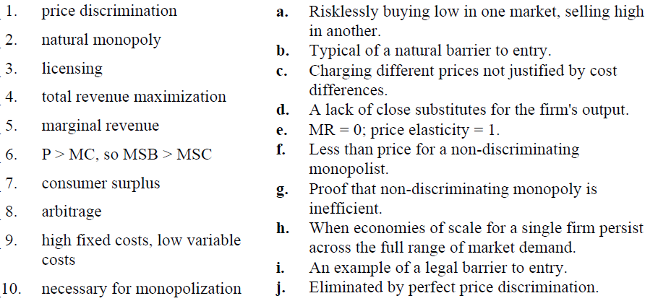
Q2. MATCH UP

Slide 11
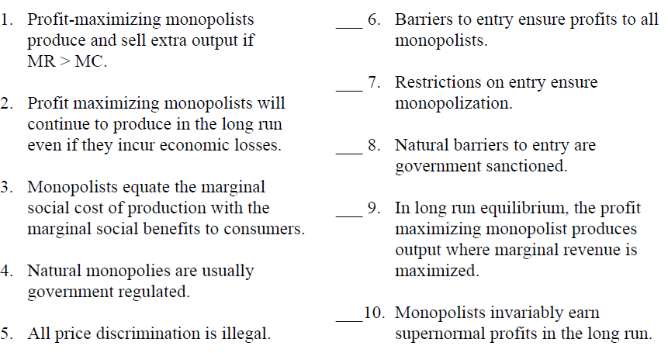
Q3. TRUE or FALSE

Slide 12
LERNER INDEX
Abba Lerner‟s 1934 paper in The Review of Economic Studies is known today as the source of the Lerner Index of monopoly power.
By identifying the social loss from monopoly as the divergence between price and marginal cost, rather than the “usually accepted” relationship between price and average cost, Lerner redirected attention from the monopolist’s profits to the allocative inefficiency created by the pursuit of those profits.
This insight is so ingrained in the mind of economists today that it is easy to overlook what a significant advance it represented.

Slide 13
LERNER INDEX……
The Lerner Index identified the “degree of monopoly” with the difference between the firm’s price and its marginal cost at the profit-maximizing rate of output.
For Lerner, a bigger wedge between P and MC meant greater monopoly power. ( P - MC ) / P

Slide 14
LERNER INDEX……
A profit-maximizing firm‟s monopoly power varied directly and only with the firm’s own-price elasticity of demand.
Lerner‟s benchmark for measuring monopoly power and discussing the welfare economics of monopoly is “the social optimum that is reached in perfect competition”.
The Lerner Index identifies the degree of monopoly along a continuum between perfect competition and monopoly.

Slide 15
Thank you LERNER
&
LEARNERS
All the very best !

